Slide 1

The AliveUI
Your Mental Health Assistant

Slide 2
Agenda
Problem statement : Why mental health?
Flow
Features
Demo
Unique features
Roadmap Ahead

Slide 3
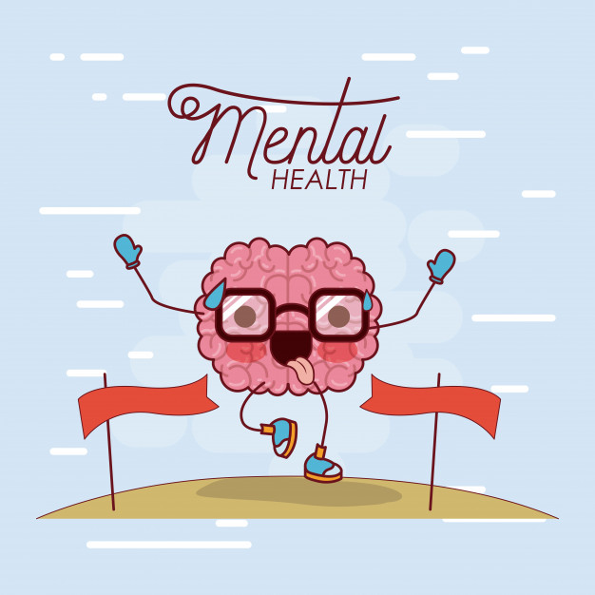
Problem Statement
There is a dire need of the
human touch,
candid conversation
stress management and
thoughtful solutions
to address the current COVID
situation.

Slide 4
Seven stages of mental health
Pre-conception
Contemplation
Seeking Help
Engagement
Recovery
Maintenance
Crisis

Slide 5


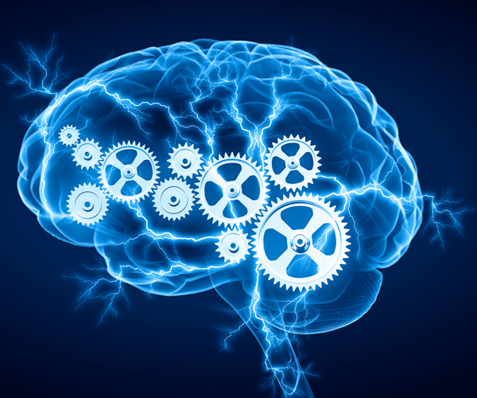

Our Solution
Chatbot
Personalized solution.
Mental Health Tests
Community Interaction

Slide 6
Flow

Slide 7


Slide 8
Flow Diagram
Front End
Back End
Database layer
Sign In
Fetch Details
of User
User Database
Mental Health Test
Find Relevant Questions on the basis of user and answer chosen
End User
User
Question Database
Question with Options
Give Response
Submit Test
Calculate Score according to response
User wants to check his/her stress or anxiety level and need some useful stuff to decrease stress
Estimated Score and Summary of his Problem with Relevant Therapy
Recommend Therapies on the basis of score and user interest
Recommendation Database

Slide 9
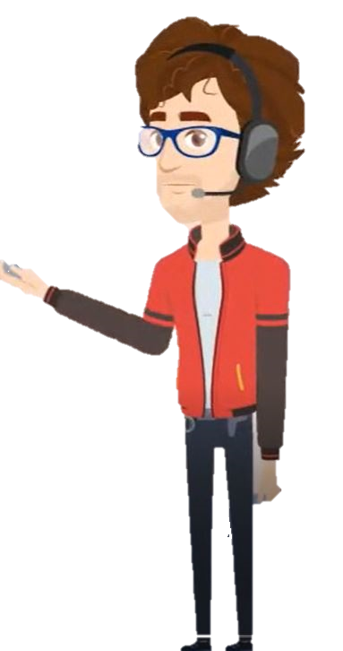
Features
Mental health tests
Personalized Therapy Section
Oliver Chatbot- Made by using IBM Watson
Community Connect

Slide 10

Mental health tests
Depression Test
Anxiety Test
Stress Test
Our analysis
Continuous Progress Tracking

Slide 11





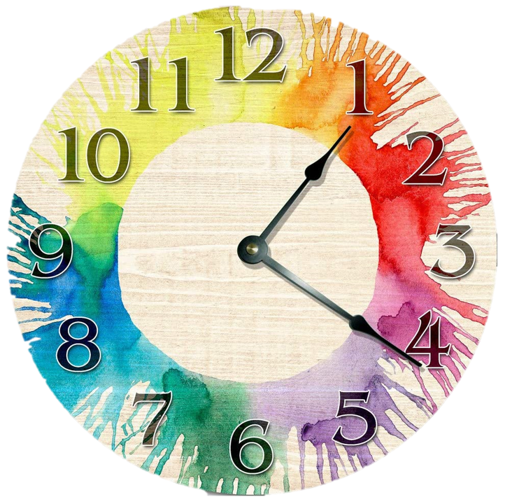
Personalized Therapy Section
Mental Well Being
Physical Well Being
Music Therapy
Reading therapy
Time Management Therapy
Talking to our chatbot

Slide 12
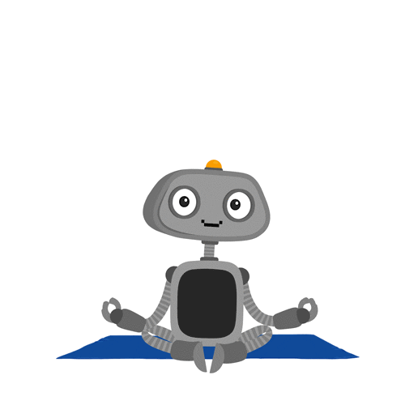
Oliver Chatbot
Conversations cut shot half the problems.
Inline suggestions
Oliver is an all weather friend!

Slide 13

Community Connect
Importance of Community
Connecting with people around
Community events!

Slide 14

Alive UI features for 7 stages
Pre-conception
Contemplation
Seeking Help
Engagement
Recovery
Maintenance
Crisis
}Stress Test
}Oliver Chatbot
}Community Page
}
Continuous evaluation and recommendation
based therapy

Slide 15
Demo

Slide 16
Unique Features
A very lively and comfortable UI
A personalized recommendation system
Community Connect Feature
Minimal cost
Caters to all seven stages of Mental Health

Slide 17

Roadmap ahead
Ideas
Page
Workshops/
Events
Integrating ML
Opportunities
Section
Community
Gathering
Skills Page
Adding therapies
based on user
feedback
Anonymous Chat Feature

Slide 18
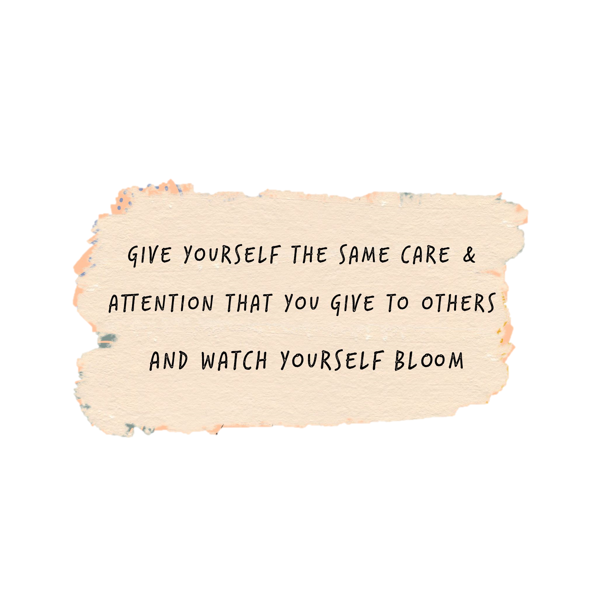
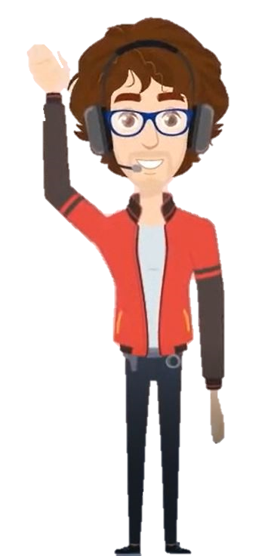
Thankyou.

